Slide 1
Crime Buster
Team Tardigrade

Slide 2
Team Members & Roles
Angel Cheng ---- Requirements & Team Facilitator
Sam Mendimasa ---- Design Leader
Katelyn Seitz ---- Implementation and Testing Leader
Zach Vance ---- Delivery Leader

Slide 3

Project Motivation & Background
Crime occurrences are not random.
Crime Buster designed to help officers gain insight to predict what, when, and where the next crime will happen.
Uses past data to predict future crimes by allowing officers to visualize the data in the most beneficial ways.
Example: if the data shows a spike in crimes at a certain location every Friday night, the police department can deploy extra officers to that area to prevent the crime before it happens again.

Slide 4


Requirements gathered
Where did we gather our requirements?
Client: Jonathan Pautsch
User: UMBC Police officer
What’s important/interesting in the data source?
Location; Time; Crime Type; Weapon; Indoor/outdoor
visualization type choice?
Map; Graph(Heat Map); Chart; Table

Slide 5
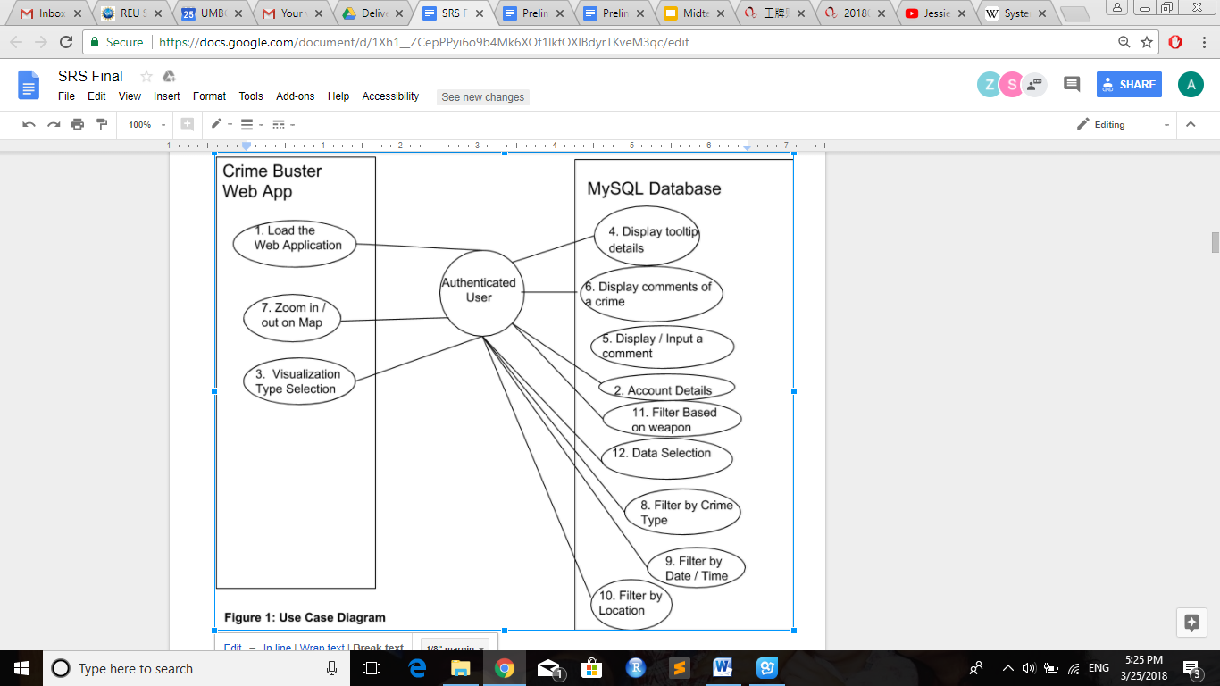
Use case Diagram

Slide 6
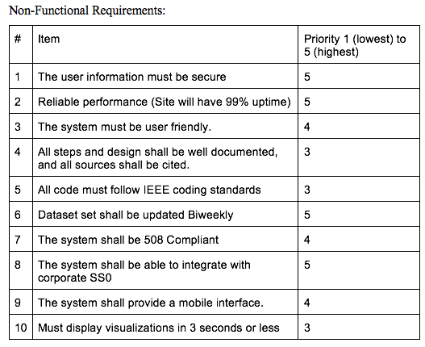
Non Functional Requirement

Slide 7
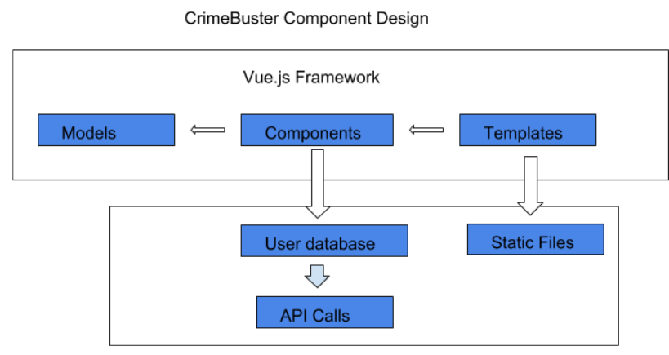
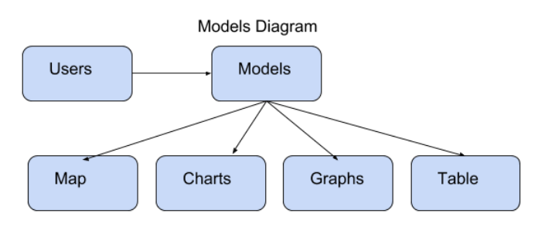
Design Approach
Architecture Design: Vue.js and Node.js Framework
Technical platform: Windows server/web page.
Software selected: Sqlite

Slide 8
Prototype

Slide 9
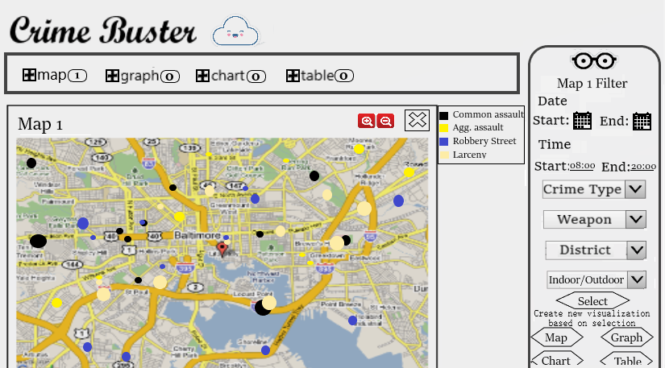
Paper Prototype
Home Page

Slide 10
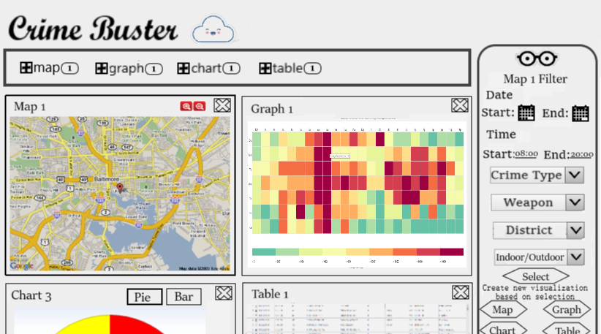
Paper Prototype
Showing 4 different visualizations on the same page

Slide 11
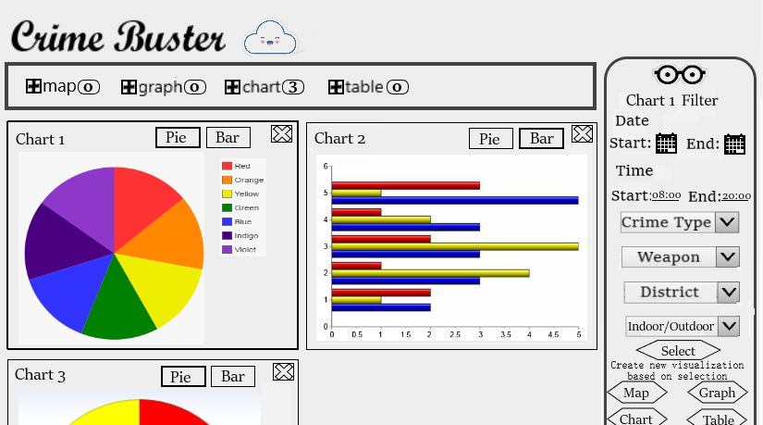
Paper Prototype
Showing 3 same visualizations with different filtered data

Slide 12
Questions?

Slide 13
Thank you
Team Tardigrade

